Slide 1
NE 795-014: Advanced Reactor Materials
Fall 2023
Dr. Benjamin Beeler

Slide 2
Last Time
Graphite radiation damage: point defects and Mrozowski cracks lead to shrinkage
Shrinkage and creep are dependent upon stress state
Large temperature and stress gradients in graphite structural components
Irradiation creep is very important in graphite and relieves large induced stresses
Fuel fabrication processes for particles and pebbles/compacts
Covered key fuel failure mechanisms
Overpressure; IPyC cracking; IPyC and SiC debonding; Kernel migration; Fission product attack; Creep failure of PyC; SiC decomposition; KCMI
TRISO-coated fuel is usually designed such that none of the fuel failure mechanisms are expected to be significant

Slide 3
Material Performance in He

Slide 4
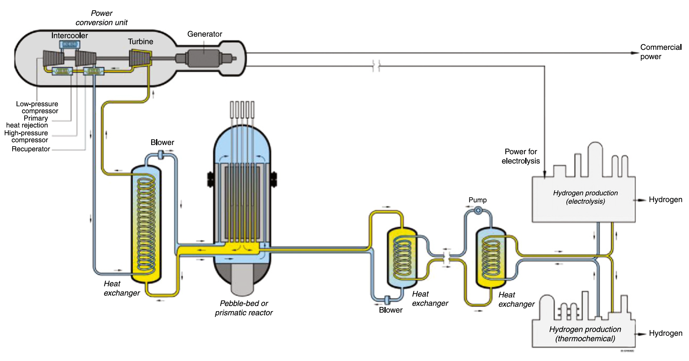
High Temperatures
Current designs target 750 C coolant outlet temperatures
Process heat requirements may require outlet temperatures up to 950C
The most critical metallic component in the VHTR system is the intermediate heat exchanger (IHX)
The high temperatures and long duration of operation restrict IHX material selection

Slide 5
Flow and Impurities
In the reactors under consideration, the gas pressure is typically between 5 and 7 MPa
The coolant is circulated at high velocity, sometimes over 100 m/s
Operating experience has shown that the primary He coolant tends to contain H2O, H2, N2, CO, CO2, and CH4 at concentrations of a few parts per million
These are the primary drivers of corrosion in He-cooled systems
Reactor systems need to have extensive gas cleanup systems associated with the helium coolant flow to keep the total impurity levels in the helium below typically 10 ppm
Active control should be maintained on the H2O and CO concentrations to reduce oxidation of the graphite
Molecular sieves are effective in capturing most of the gaseous impurities

Slide 6
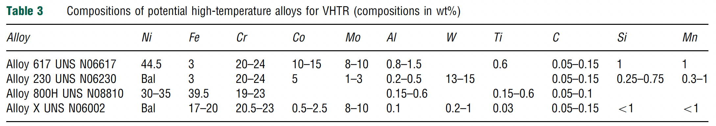
IHX Materials
The desire for higher temperature operation led to selection of nickel-based alloys
These alloys rely on the formation of a chromia layer for long-term protection from environmental degradation
The alloys are primarily solid-solution strengthened with carbides on the grain boundaries to improve creep resistance

Slide 7
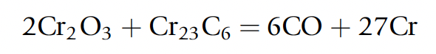
IHX Corrosion in VHTR
Interplay between the alloy surface, temperature, and gas composition determines whether corrosive oxidation, carburization, or decarburization occur
Carburization is associated with low-temperature embrittlement, and decarburization is linked to reduced creep rupture strength
Ideally, a continuous self-healing, impermeable passivating oxide layer is needed to establish the most corrosion resistant alloy
There is a critical temperature above which the oxide layer is unstable and CO evolution will occur

Slide 8
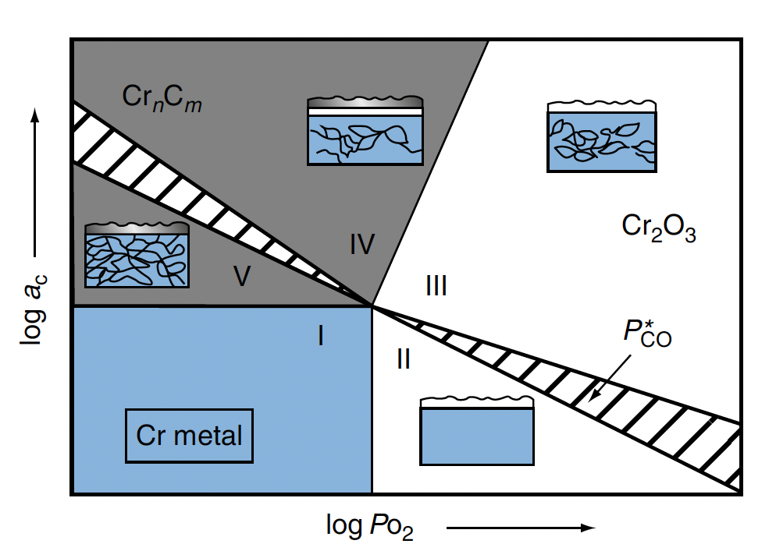
Alloy 617 Stability
Alloy 617 is the leading candidate for use in the VHTR heat exchangers because it has the highest creep strength of the solid-solution alloys under consideration for temperatures above 850C
Five conditions: I – strong reduction; II – decarburization; III – stable external oxide; IV – mixed surface oxide and carbide; and V – strong internal and external carburization
Zone 3 is optimal for stability

Slide 9
TRISO Fuel Performance

Slide 10
TRISO Fuel Performance
Fuel performance models need to be able to account for numerous inter-related phenomena that affect temperatures, stresses, and failure of the material systems
Must be multiphysics, incorporating thermodynamics, chemistry, kinetics, microstructure, mechanics, etc.
Solid fission product swelling
Gaseous fission product swelling
Densification
Thermal conductivity
Fission gas release
CO production
Oxygen transport
PyC layer dimensional change
Kernel migration
SiC failure
Fission product attack

Slide 11
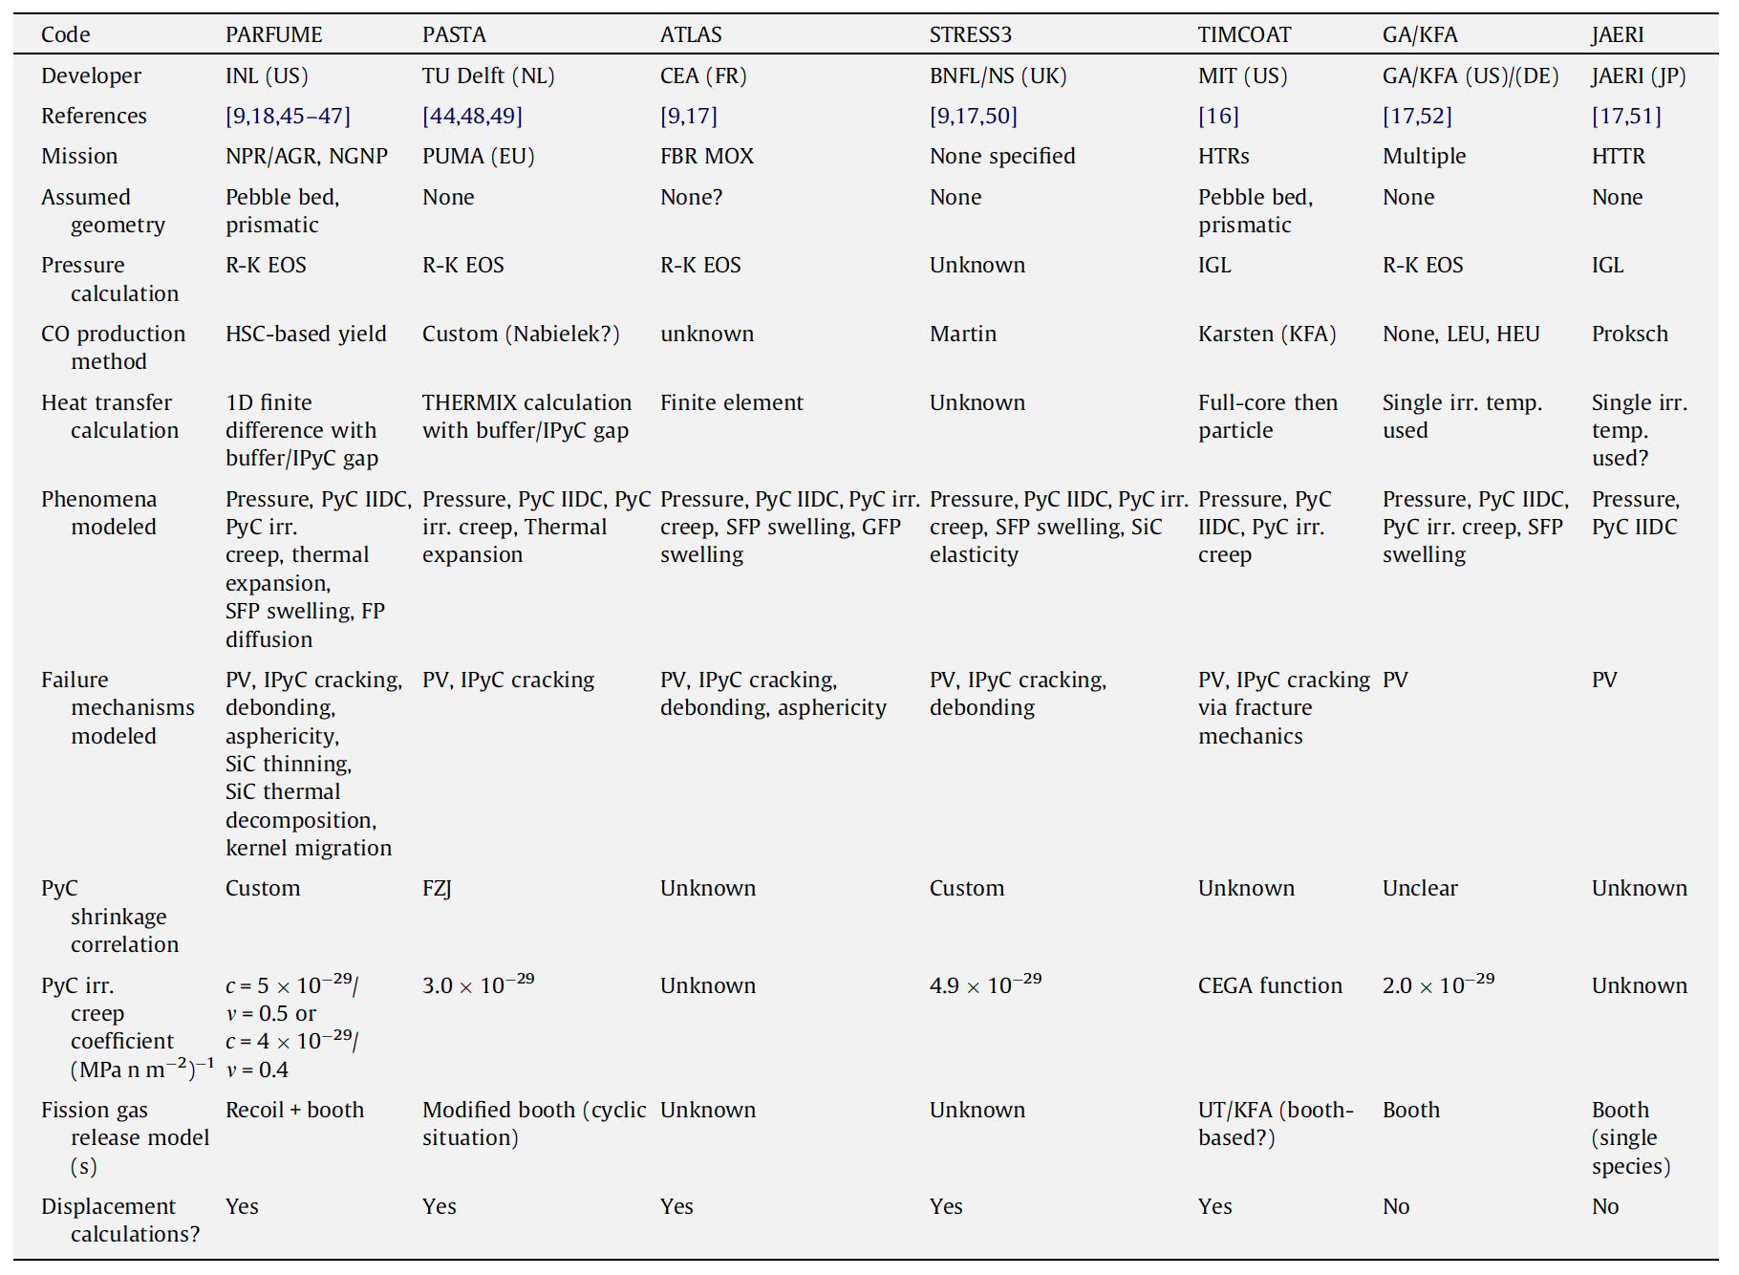
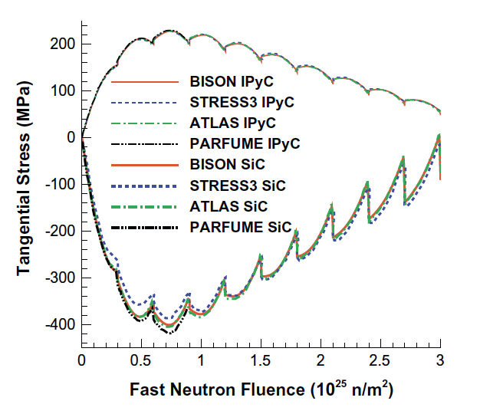
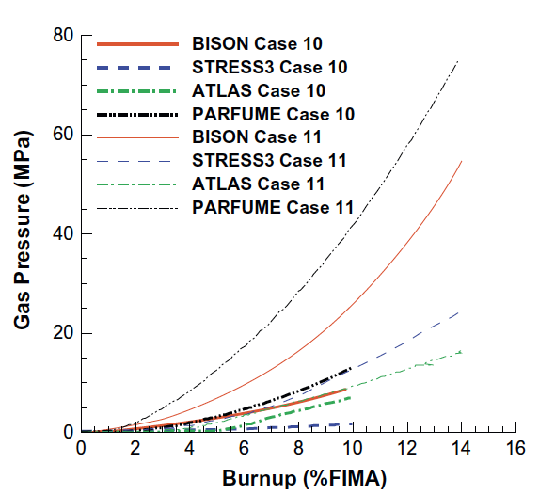
Fuel Performance Codes

Slide 12
SiC Failure
The dominant 1D failure mechanism for TRISO fuel particles involves pressure vessel failure, where the SiC layer develops a through-thickness crack resulting from a tensile stress that exceeds the fracture strength of the material
Modern approaches to pressure vessel failure explicitly calculate separate stresses and through-layer crack probabilities for the SiC layer and each PyC layer

Slide 13
TRISO Stresses
The irradiation causes the kernel to swell and the buffer layer to shrink, thereby modifying the internal void volume available to the fission and reaction gases
The porosity of the buffer leads to the gas pressure being the only force on the load-bearing layers
If the IPyC and OPyC were absent, the gases produced in the fission process would simply stress the SiC layer and, if the pressure were high enough, cause it to fail
However, these tangential stresses are reduced by the presence of the two PyC layers because; under unrestrained conditions they would shrink during irradiation

Slide 14
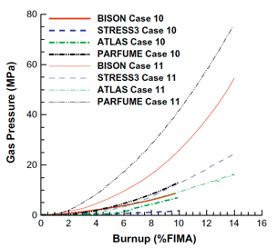
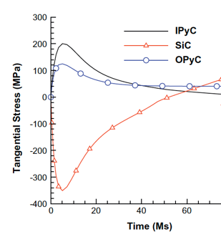
TRISO Stresses
PyC shrinkage will be largely restrained by the SiC layer, and tangential stresses will be generated in both PyC layers, with radial (inward) acting forces imposed on the two surfaces of the SiC layer
In practice, these tangential stresses in the two PyC layers will attain a quasi-equilibrium stress state because their shrinkage is counter-balanced by irradiation creep
The SiC elastic modulus is at least an order of magnitude greater than that of PyC and thus, the dimensional changes and creep strains of SiC are comparatively much smaller than for PyC

Slide 15
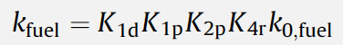
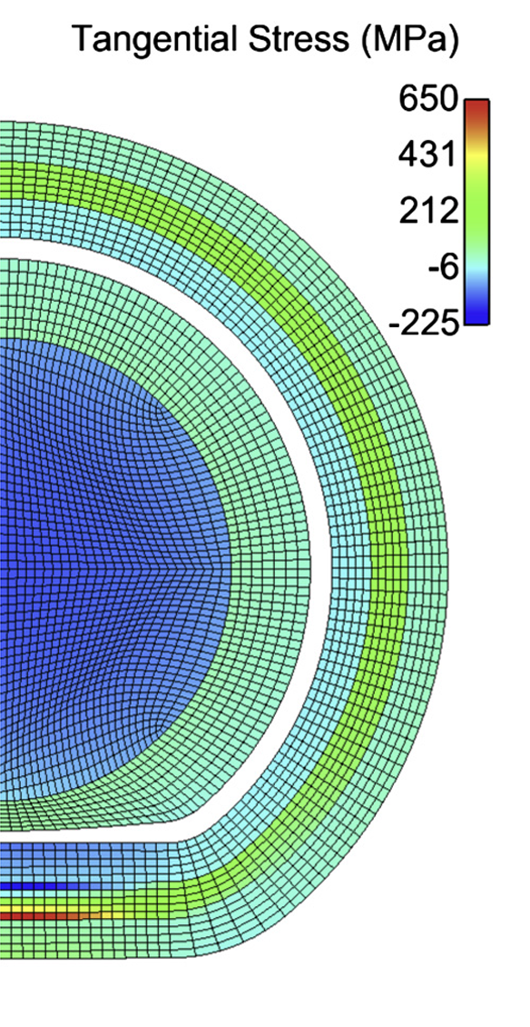
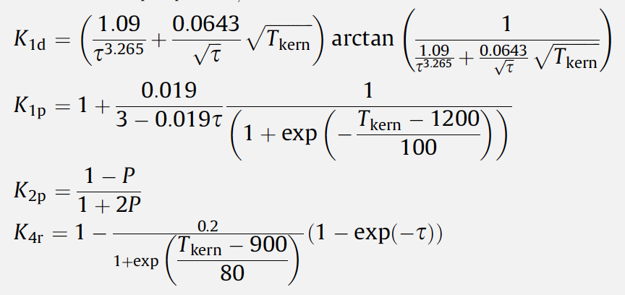
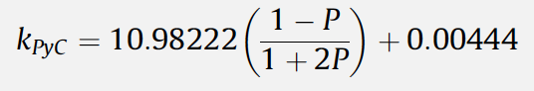
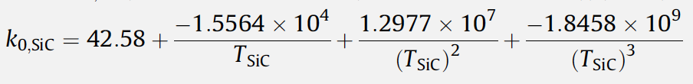
Material Evolution
Ideally, would be able to model and describe 3D modes of failure
Shrinkage cracks within the IPyC layer
IPyC/SiC debonding
Particle asphericity
Kernel migration
SiC coating thinning
Fission product attack

Slide 16
Data needs
There are a number of areas where we lack requisite data, either behavioral or fundamental properties, in order to accurately describe TRISO particle evolution
High-quality high burnup data on TRISO particles is generally lacking, which would enable benchmarking of fuel performance models
Uncertainties and unknowns in fundamental material properties are also abundant, especially with regard to how properties vary as functions of temperature, fast fluence, and burnup
There is significant uncertainty in the irradiation creep constant, the value of Poisson’s ratio in irradiation creep models, and the thermal conductivity of PyC
Predictions for the chemical attack of SiC require effective diffusion coefficients of key fission products in various fuel materials, which are unknown
Fuel properties are the least well understood, especially as the fuel evolves during operation

Slide 17
Advanced concepts in TRISO

Slide 18
ZrC replacing SiC
Zirconium carbide (ZrC) is a refractory and chemically stable compound, which melts eutectically with carbon at 3123 K
ZrC can potentially improve the high-temperature stability, the resistance to chemical attack by fission products, and the retention of fission products
However, ZrC is significantly less oxidation resistant than SiC

Slide 19
ZrC replacing SiC
Four types of ZrC inclusions have been studied (1) ZrC-TRISO coated particles, (2) ZrC-TRISO type coated particles without OPyC layer, (3) ZrC-coated particles with ZrC-doped OPyC layer, and (4) ZrC coated particles with graded C–ZrC layer(s)
All four types have been fabricated and irradiated
Primary focus has been on option 1, however usage of ZrC started from option 2 in the 1970s
ZrC-TRISO-coated UO2 particle after irradiation at 1673–1923K to 4.5% FIMA

Slide 20
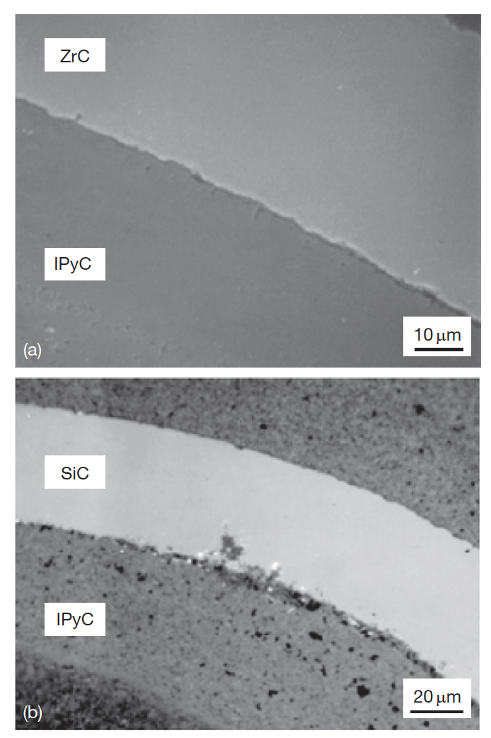
ZrC replacing SiC
The improved performance of the ZrC coating layer against chemical attack by Pd has been demonstrated in both out-of-reactor experiments and irradiation tests
ZrPd3 can form in lab conditions, but insufficient Pd exists in fuel particles to cause formation and thus degradation
ZrC does not seem to solve the silver problem
Ruthenium release might be an issue, which it is not for SiC

Slide 21
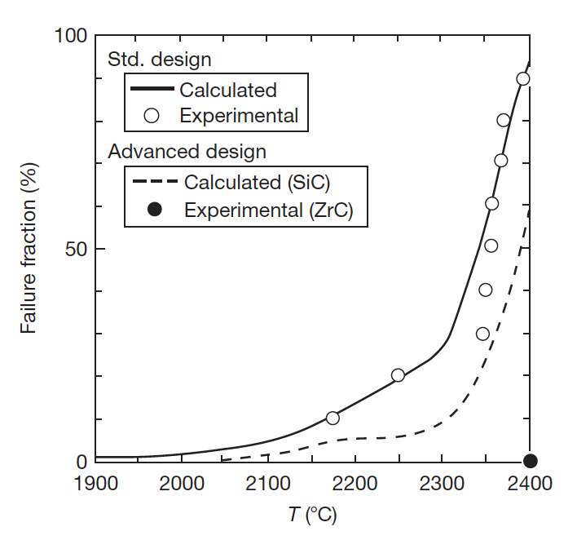
ZrC replacing SiC
High-temperature behavior of ZrC is superior to SiC
Right is a heating experiment on irradiated TRISO particles
No ZrC failures up to 2400C, where an extended hold produced a failure
At temperatures above 2000C, SiC will decompose into its constituents
Thus, better stability during fabrication, ability to operate at higher temperatures, better stability in off-normal temperature spikes, better fission gas retention at high temperature

Slide 22
Non-fissile Carbides in Fuel
To inhibit the buildup of CO gas in UO2 fuel kernels, UC2 is often added to getter oxygen and reduce the oxygen potential
Similar results can be achieved by the addition of nonfissionable carbides, such as SiC or ZrC around fuel kernel
Added as a layer around UO2 fuel kernels and/or dispersed within the buffer
As-fabricated
Irradiated

Slide 23
Non-fissile Carbides in Fuel
Introduction of ZrC around fuel kernel getters released oxygen
This seems to inhibit fuel kernel migration
If the layered ZrC is intact, can inhibit fuel swelling as well, potentially reduced stresses on outer layers
Have performed limited irradiation experiments with no failures
If the layered ZrC is intact, no release occurs for Ag and Eu
Release occurs for both species under same conditions for nominal TRISO and for ZrC dispersed in buffer
An intact ZrC layer seems to be necessary for explaining the outstanding retention of these particles, in addition to the benefits of O gettering

Slide 24
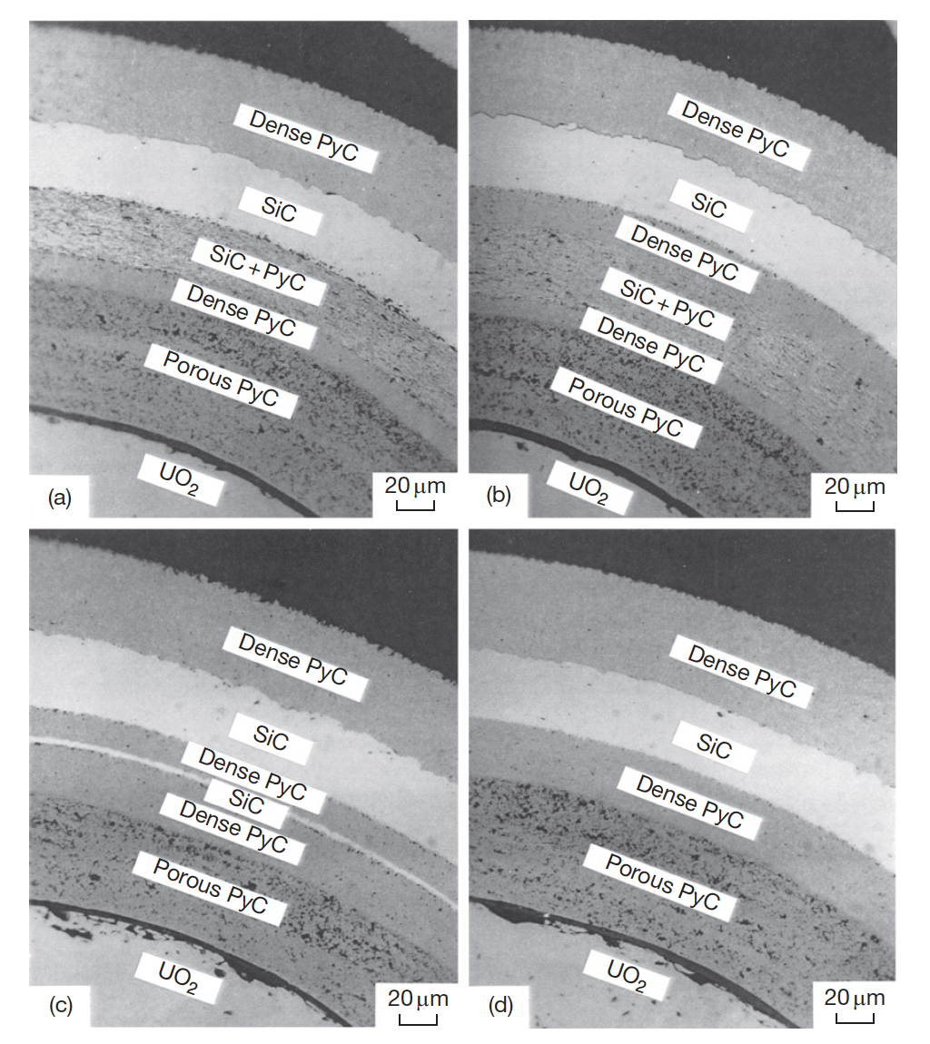
Alternate Layering
Two methods are available to prevent the corrosion of the SiC layer: (1) to keep the fission products within the fuel kernel and (2) to make a barrier to the diffusion of the fission products to the SiC layer
Can potentially add a layer that traps palladium by chemical reaction inside the SiC layer of the TRISO coating
Can add either an additional SiC layer, or a SiC/PyC composite layer

Slide 25
Alternate Layering
The type-A coating has an additional layer of SiC+PyC adjacent to the inside of the SiC layer; the thickness of the IPyC layer can be reduced
The type-B coating has the dense PyC layer between the SiC+PyC and SiC layers; the intermediate dense PyC layer will interrupt extension of the corrosion zone from the SiC+PyC layer to the SiC layer
In the type-C coating, SiC is used for an additional layer; SiC layer will react with fission products and PyC will interrupt corrosion of outer SiC

Slide 26
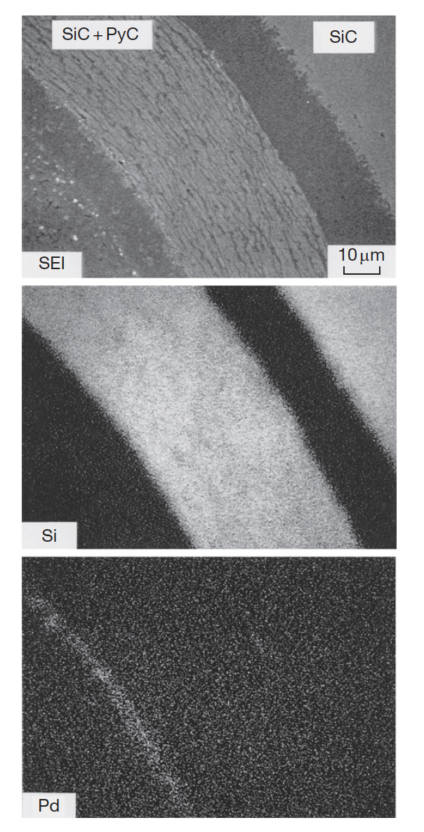
Alternate Layering
Irradiation of these advanced coatings was performed in the JRR-2 reactor
Ceramography revealed no crack in the advanced coating layers or in the TRISO coating layers
All three types trapped Pd at the inner SiC-based barrier, preventing corrosion of the outer SiC
At high heating, a PyC layer between the outer SiC and the inner SiC-based layer proved more effective at fission product retention
Also, the SiC/PyC layer proved more effective than pure SiC
No new technology needed to fabricate these particles
Type B Coating

Slide 27
Summary
He environment corrosion
impurity driven; primary concern is IHX
can control with cleanup systems, tailoring pO2 and carbon activity
TRISO Fuel performance
there are a number of fuel performance codes
data needs, and the evolutionary complexity of particles hold back more sophisticated modelling
Advanced concepts in TRISO particles
ZrC instead of SiC
ZrC/SiC as a layer around kernel
alternate layering of SiC/PyC

Slide 28
Questions?

Slide 29
Quiz Upcoming!
Will cover TRISO particle-based fuels
Quiz will be on Sept 12
Open ended questions covering the concepts presented in class
Closed book

